Slide 1
Restproject1(1)
Get , post , delete , put methods
Mixins
Difference between mixins and multiple inheritance

Slide 2
Purpose of restapi is interoperability between software applications.
Common language is Http
Common message format is json
In reality CBVs used to develop apis
Every CBV is child class of View class
View class present inside django.views.generic

Slide 3
from django.views.generic import Views
class JsonCBV(View):
get():
-------
put()
-------
post()
-----
delete()

Slide 4
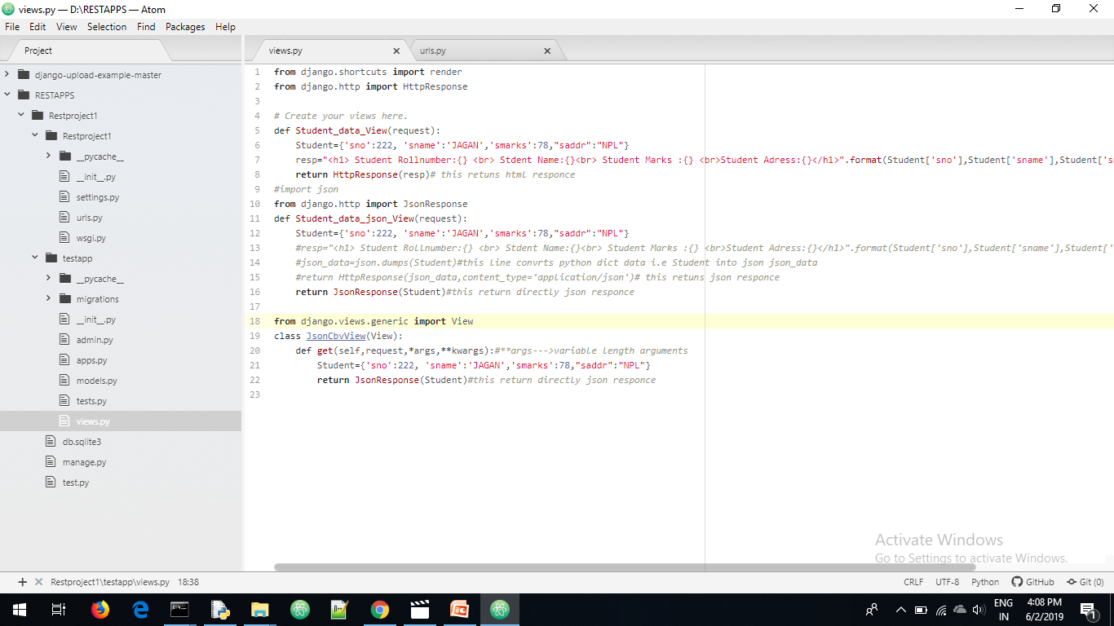
Views.py

Slide 5
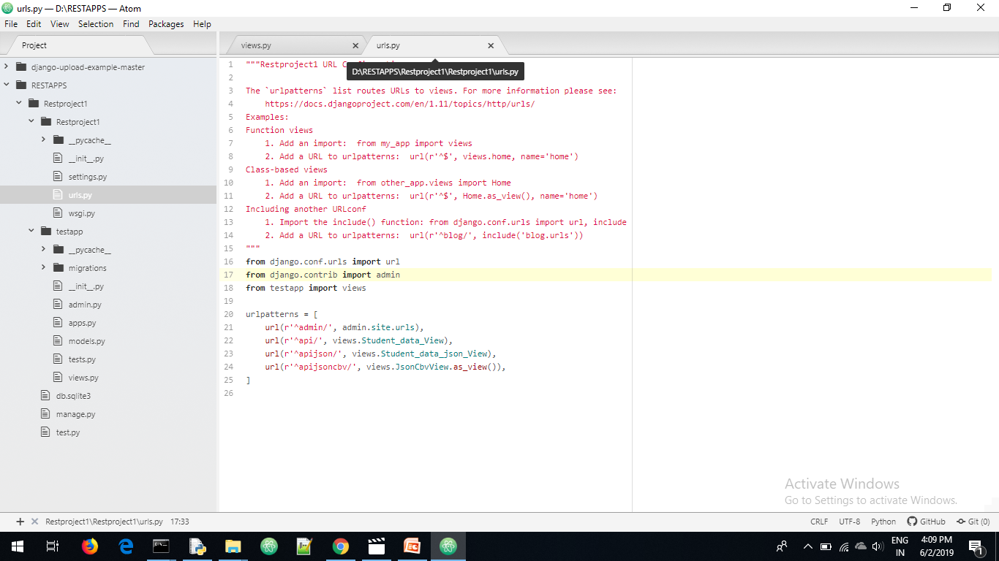
Urls.py

Slide 6
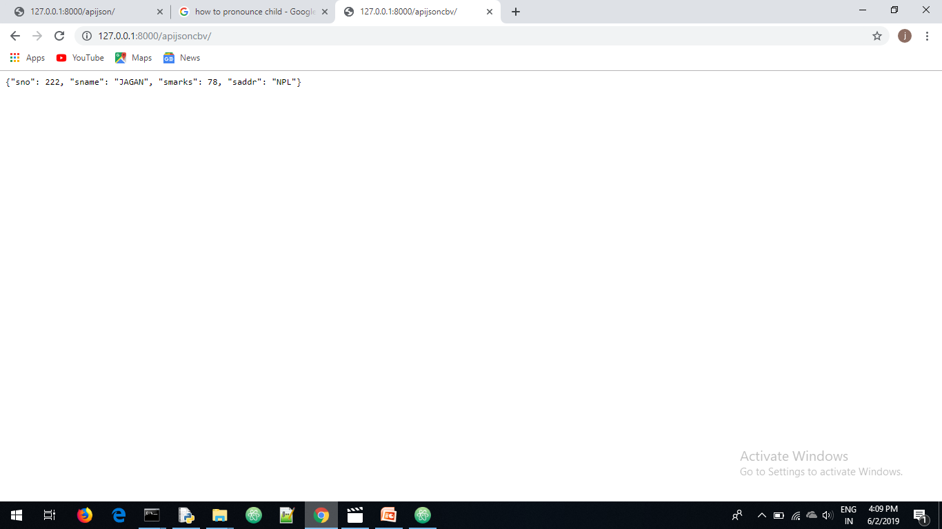

Slide 7
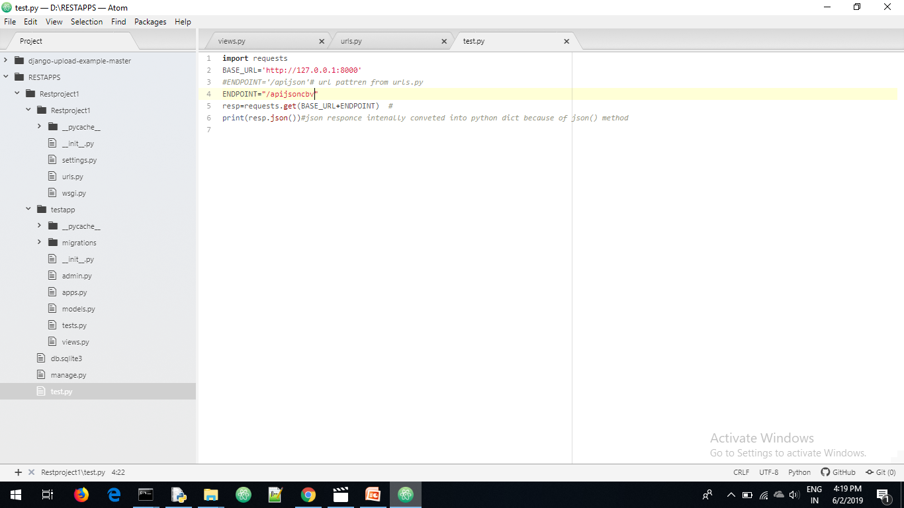

Slide 8
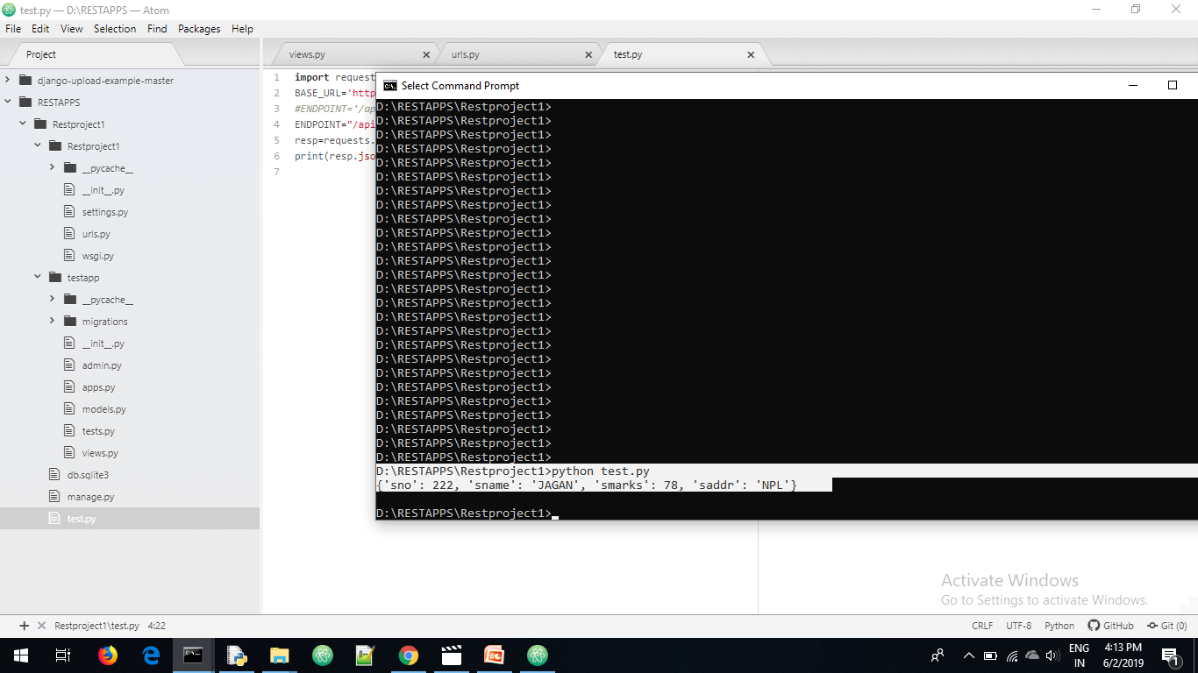
Sending request from api test.py

Slide 9
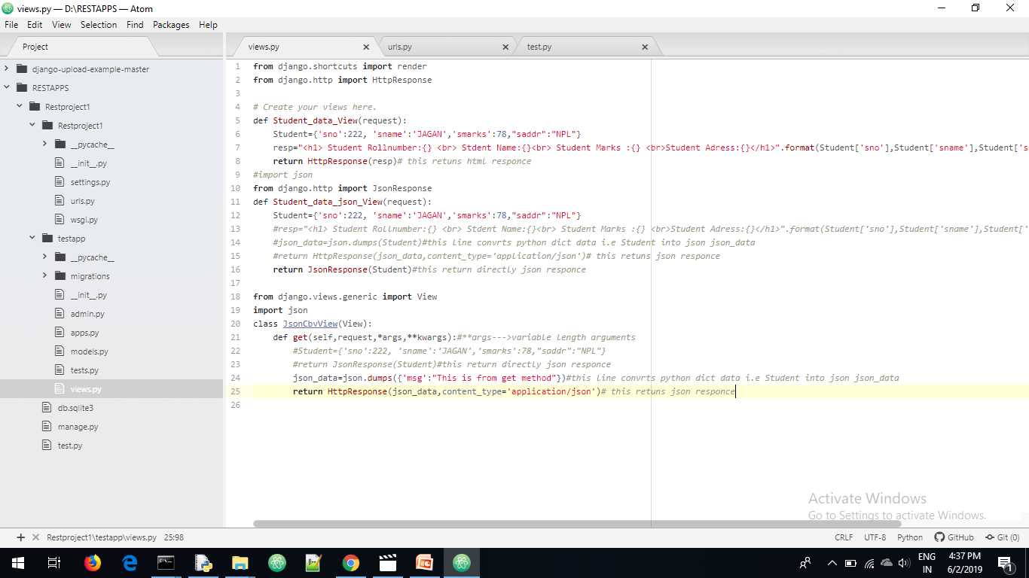

Slide 10
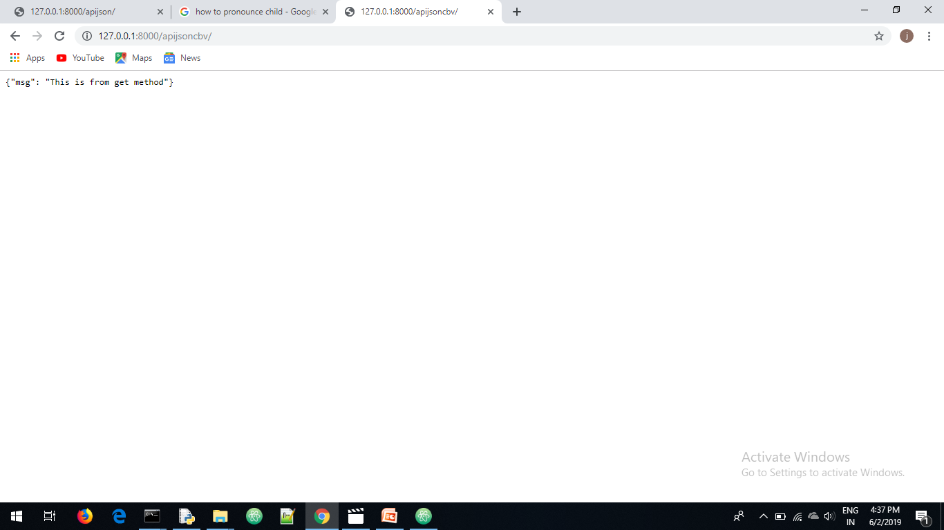

Slide 11
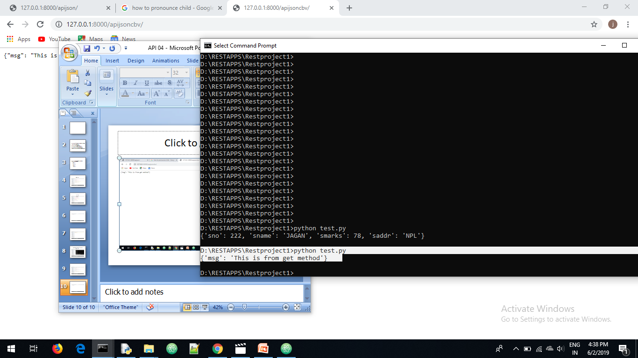

Slide 12
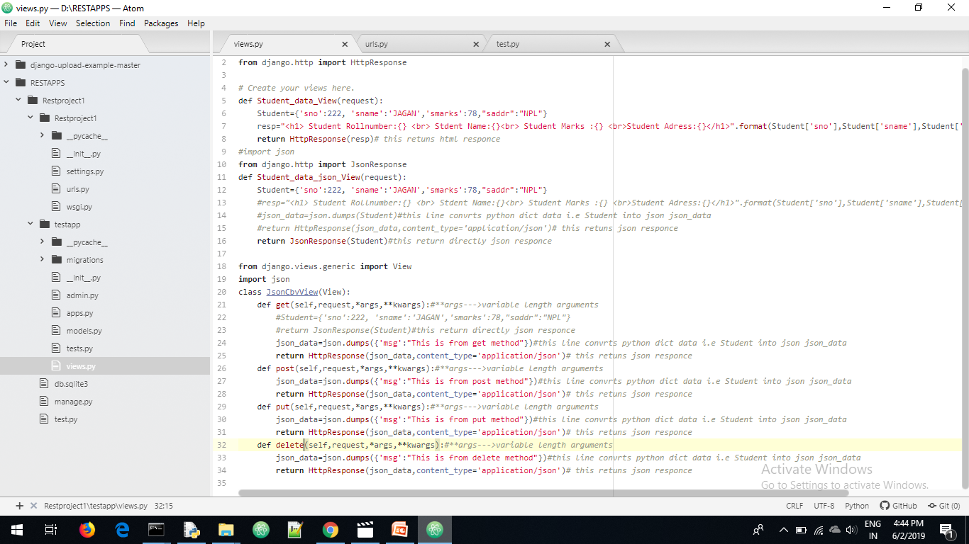
Vikews.py

Slide 13
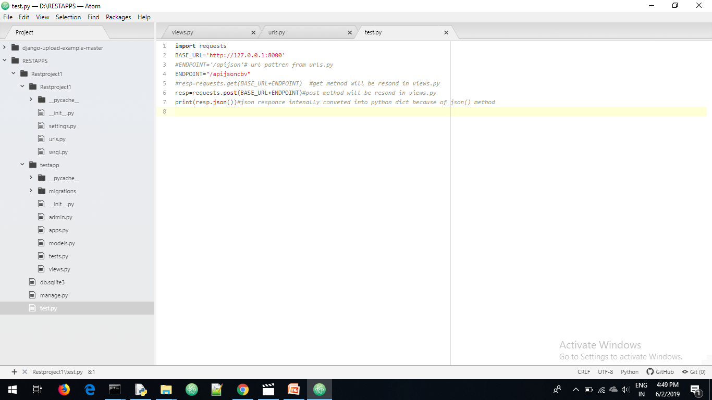
Test.py for sending post request

Slide 14
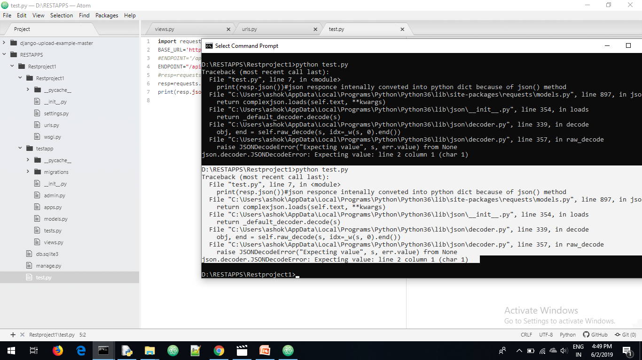

Slide 15
When sending the post request error occurred
We know already when ever sending a post request compulsory csrf token verified here we not provide csrf token for that we disabled csrf middle ware in settings.py file

Slide 16
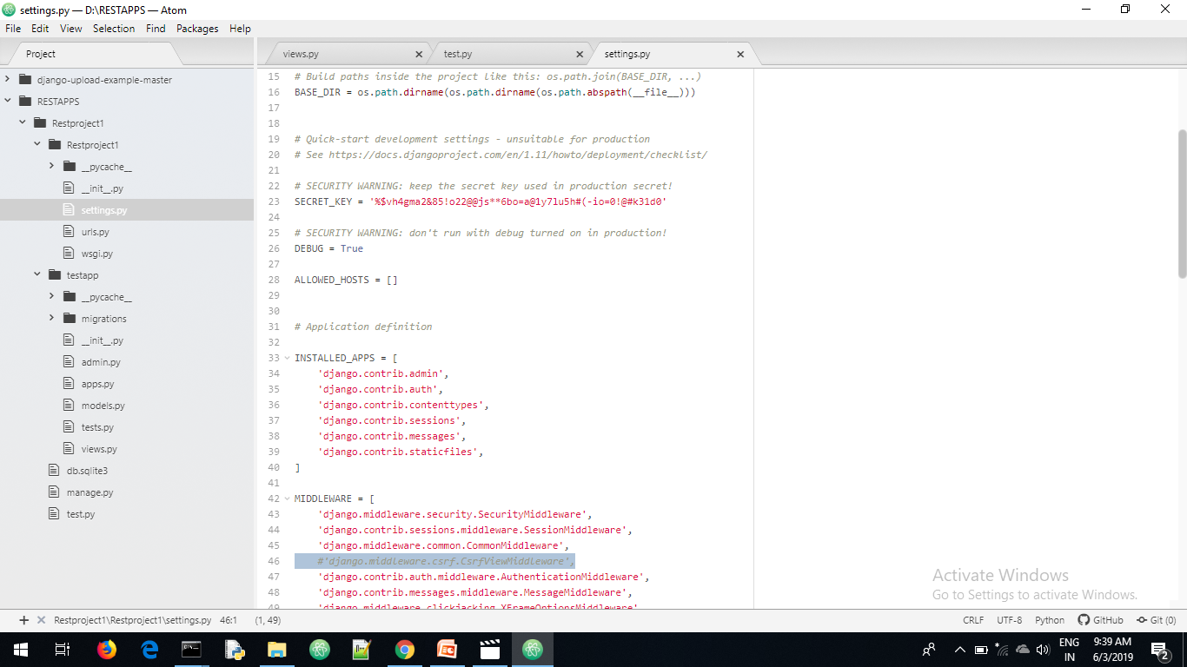
Settings.py

Slide 17
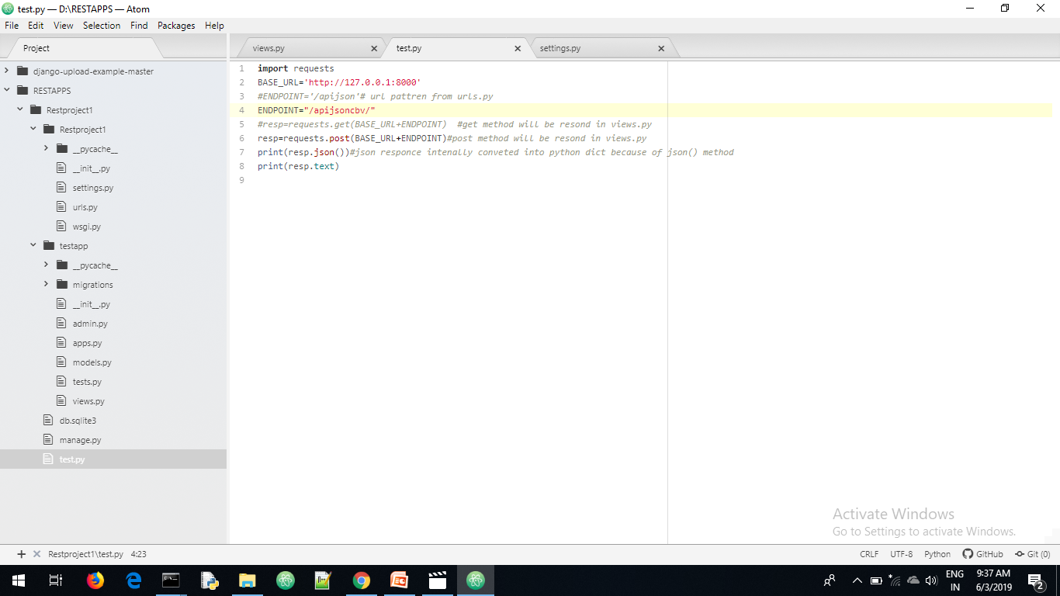
Test.py

Slide 18
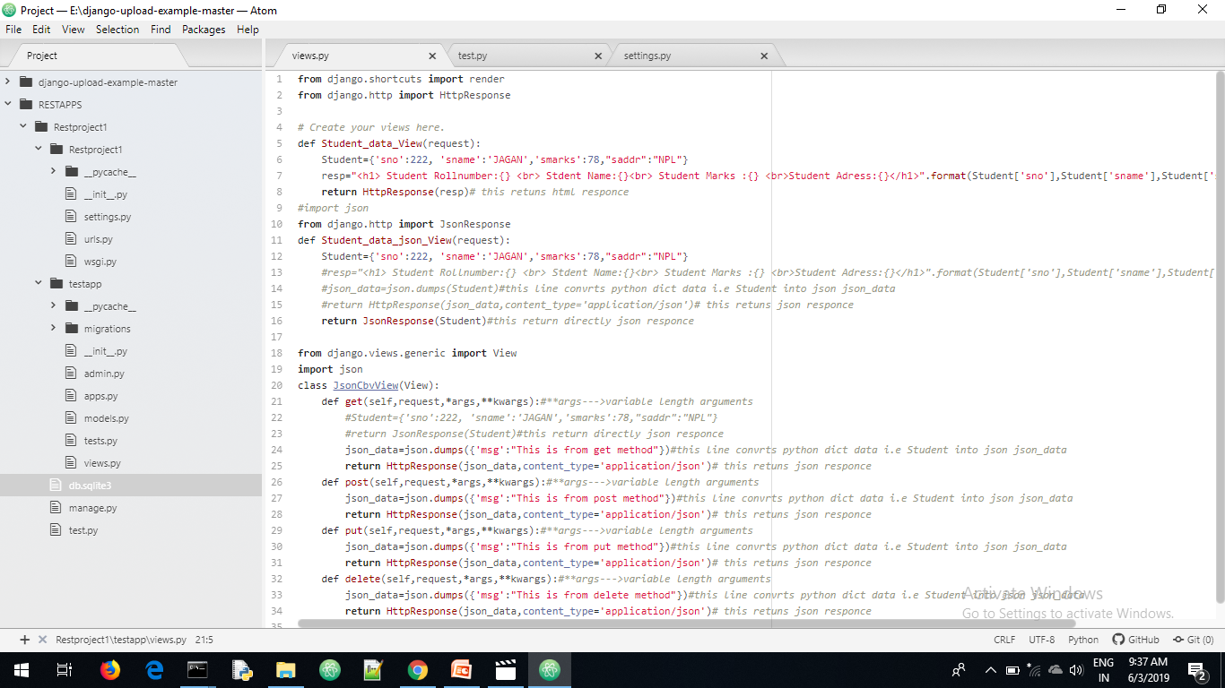
Views.py

Slide 19
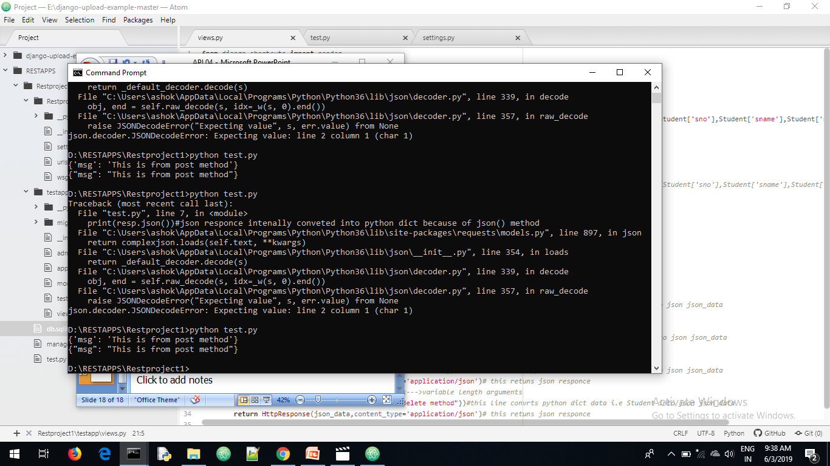

Slide 20
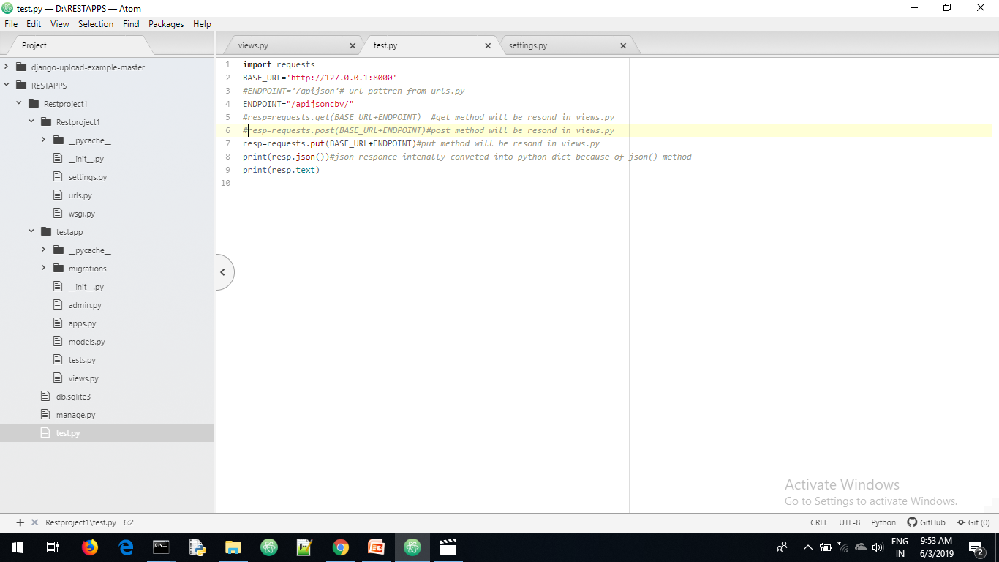
Put request from test.py

Slide 21
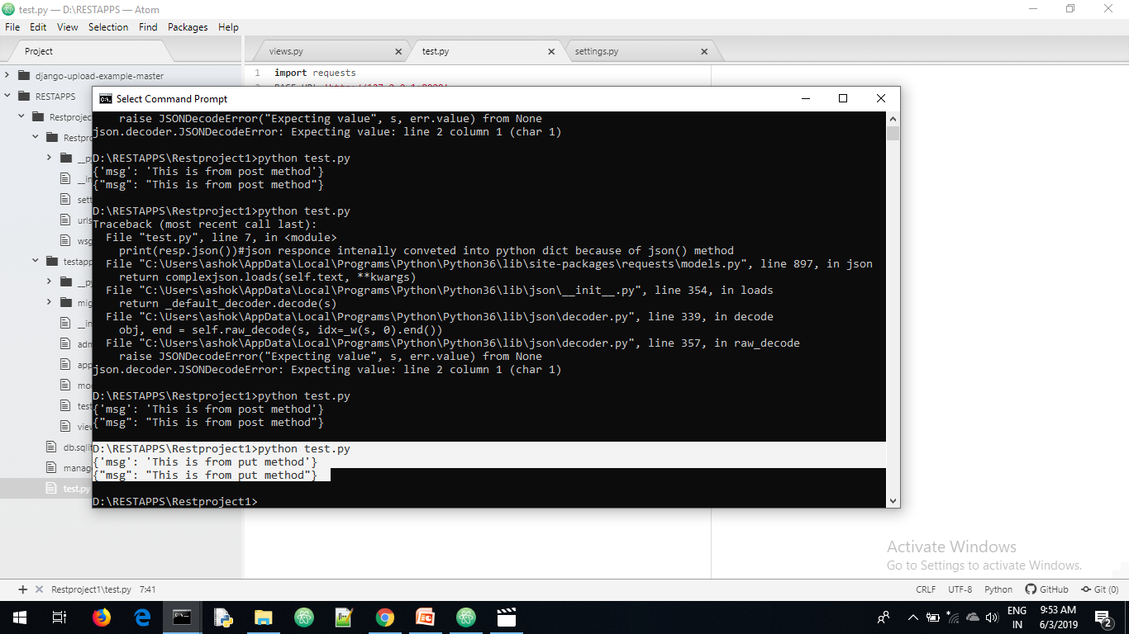

Slide 22
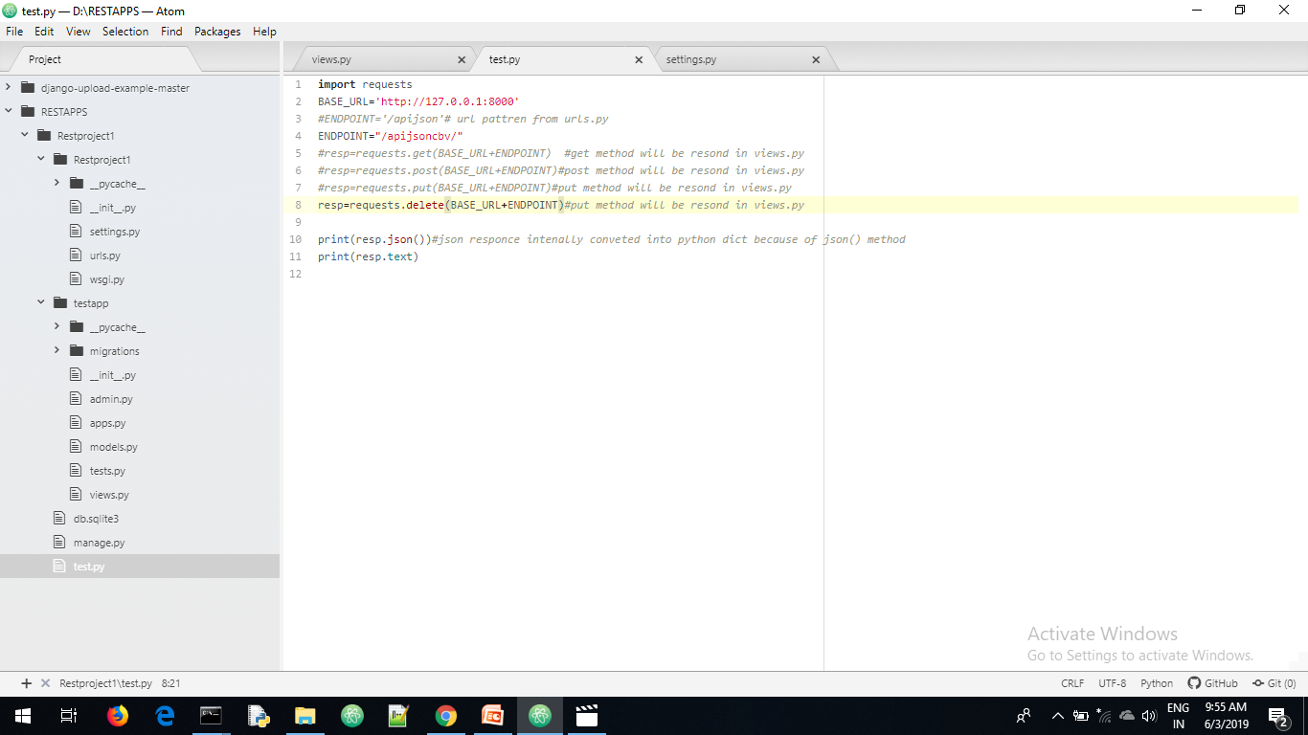
Delete request from test.py

Slide 23
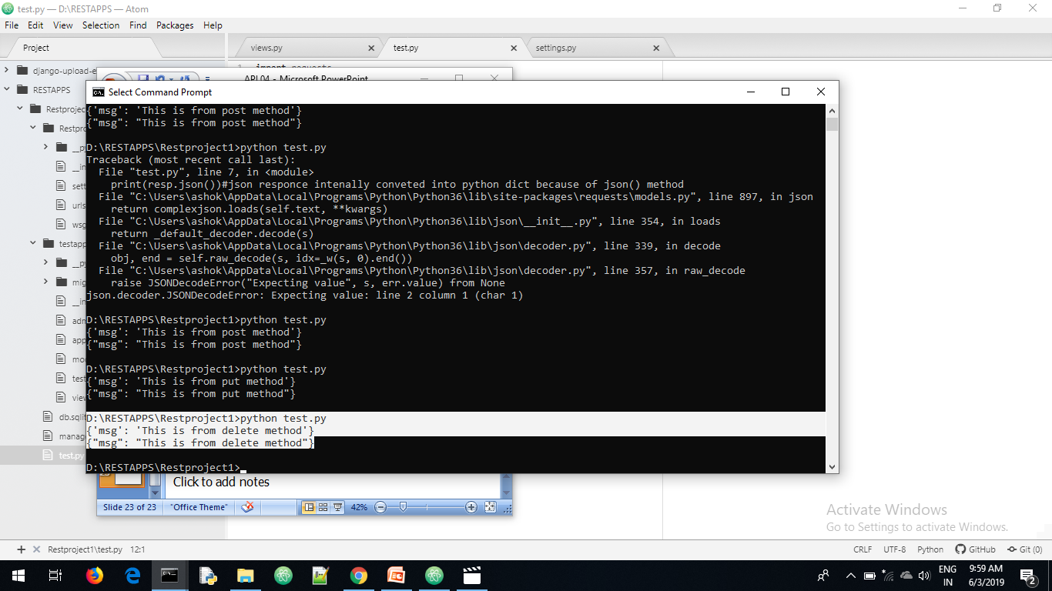

Slide 24
*args--------------→variable length arguments
**kwargs--------→variable length keyword arguments

Slide 25
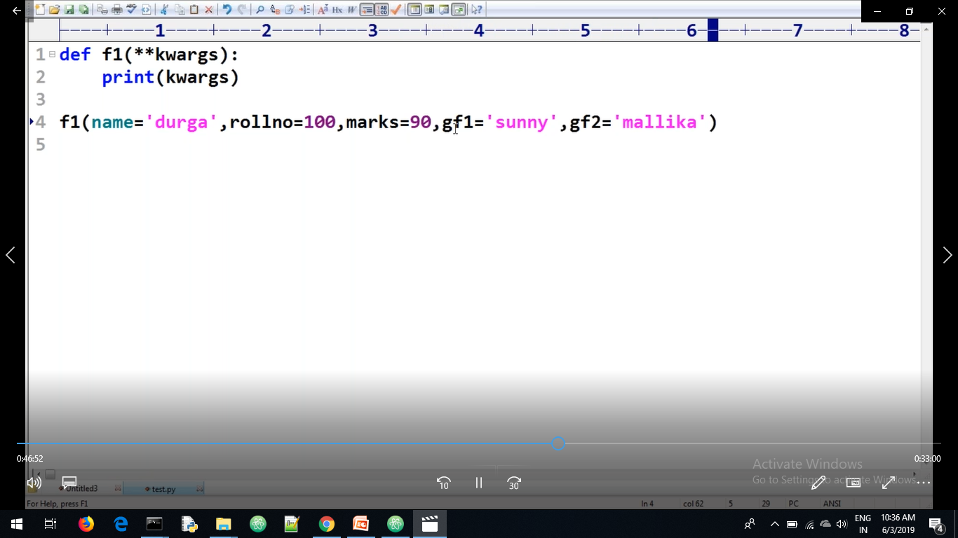

Slide 26
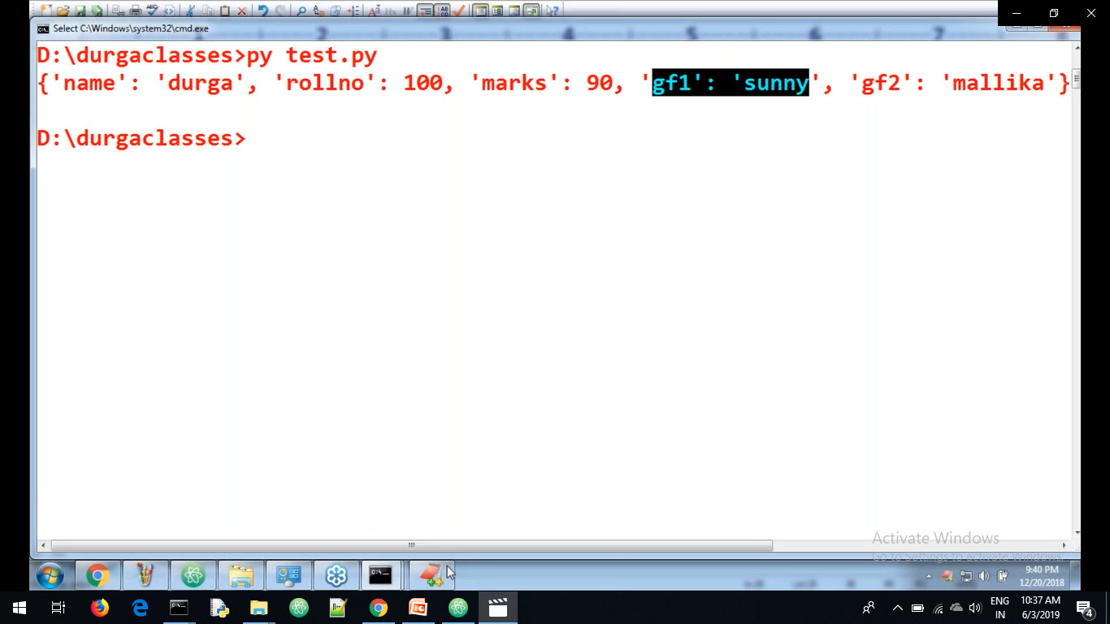

Slide 27
Mixin
Mixed in
Mixin is a class
It provides functionality to child class
It supports the only child class not parent class
Mixin is a parent class it always supports child class
For mixin class we can’t create a object
Mixin advantage is used for code reusablity is there

Slide 28
Create a mixin.py file in testapp
from django.http import HttpResponse
class HttpResponseMixin(object):#here HttpResponseMixin is parent class which provides functionolity for child class
def render_to_httpresponse(self,json_data):#render_to_httpresponse is instance method in Mixin class
return HttpResponse(json_data,content_type='application/json')#it retuns json responce

Slide 29
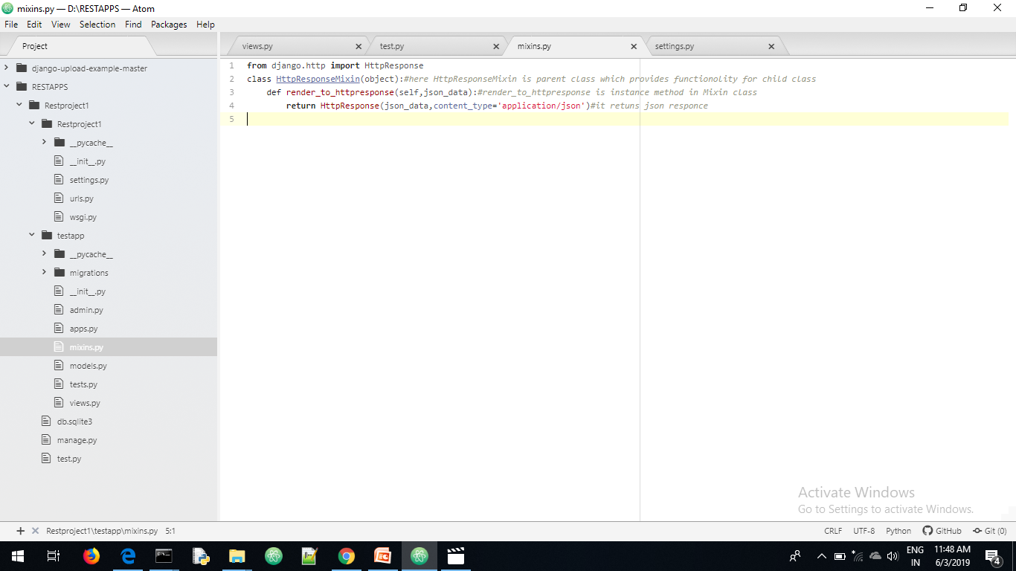
Mixin.py

Slide 30
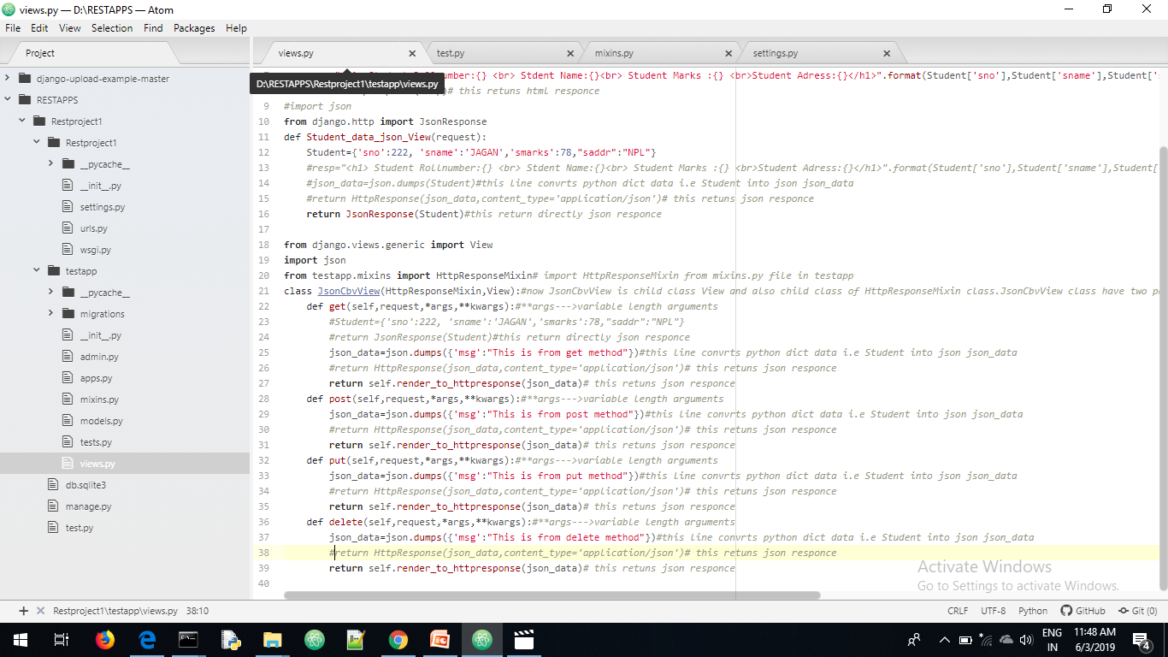
Views.py

Slide 31

Test.py Get request from API

Slide 32
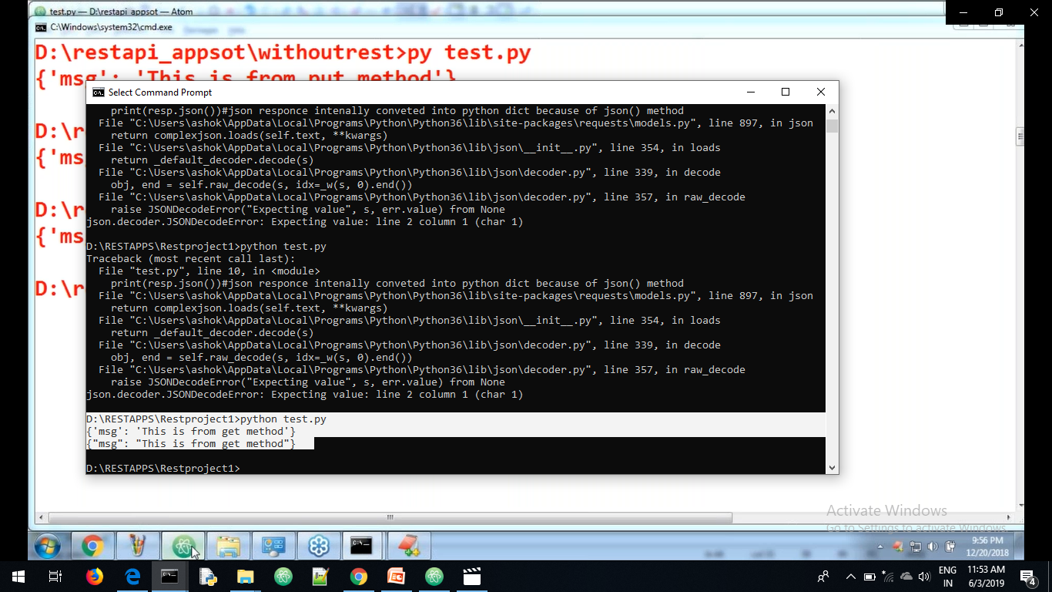
Get request from API

Slide 33
Mixin is a independent class which contains several instance methods where ever these instance methods require please make it this class as parent class that methods inside mixin class available to that class

Slide 34
Difference between multiple inheritance and mixin class
Mixclass contains only instance methods and it does not contains instance variables.
Mixin is direct class of object
Mixin for child classes only
Mixin has no parent class

Slide 35
Mixins
Multiple inheritance
Parent class instantiation is not possible
Parent class contains only instance methods but not instance variables
These methods are useful only for child class
Parent class should be direct class of object class
Parent class instantiation is
Possible
2. Parent class contains only instance methods and instance variables
3.The methods are useful for both parent class and child class
4. Parent class can extend any other class also need not be object
The main advantage of mixin is code reusablity

Slide 36
https://drive.google.com/open?id=1vlSu0UaSfX9V8p8fbbkpcC6oBvklR8oN

